Slide 1
GPS Adventure
Web Portal for Virtual Geocaching
Benjamin Parker, Westminster College
Advisor: Dr. C. D. Shaffer

Slide 2
What is Geocaching?
High Tech Treasure Hunt
GPS Coordinates
Different levels of difficulty
Take One Leave One (Trinkets)
Log (Physical and Virtual)

Slide 3
GPS Based Games
Geocaching.com & Mobile App
Walk2Build (exergaming)
Can You See Me Now?
Pac-Man Game on Campus

Slide 4

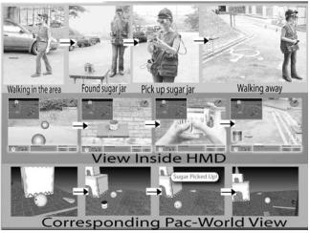

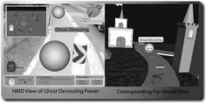
Pacman? on campus?

Slide 5
My Work: Web Portal For GPS Game
Missions
Waypoints (GPS Coordinates)
Starting Point
Title & Description
Event
Time
Mission

Slide 6
Tasks
Manage Missions
View Missions on Google Maps
Share Missions with Friends
Add waypoints

Slide 7
System Diagram
Google App Engine Datastore
Google App Engine (Python)
Google Maps JavaScript API
Google App Engine Web Server
Browser

Slide 8
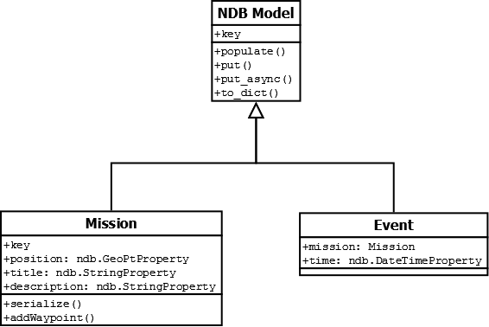
Business Classes

Slide 9
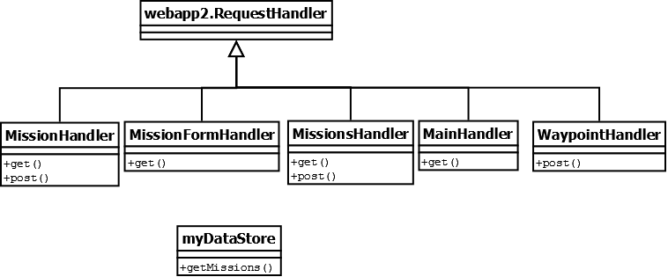
Delivery

Slide 10
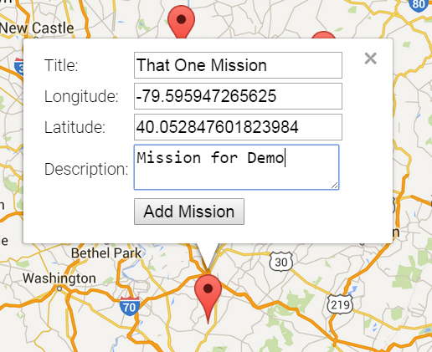
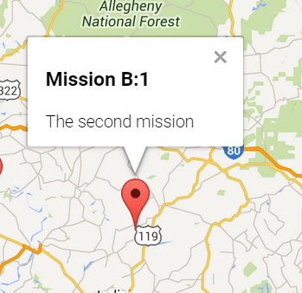
The Client

Slide 11
API
GET MissionForm | Produces the Mission Form
POST Mission | Creates a new Mission
GET Mission | Returns the Mission
GET Missions | Returns all Missions
POST Waypoint | Adds a GPS point to a Mission

Slide 12
Example Transaction
Request
POST /mission HTTP/1.1 [data]
Response (JSON)
{"desc": "Just another new mission!", "title": "New Mission",
"position": [{"lon": -79.7113037109375, "lat": 40.950862628132775}]}

Slide 13
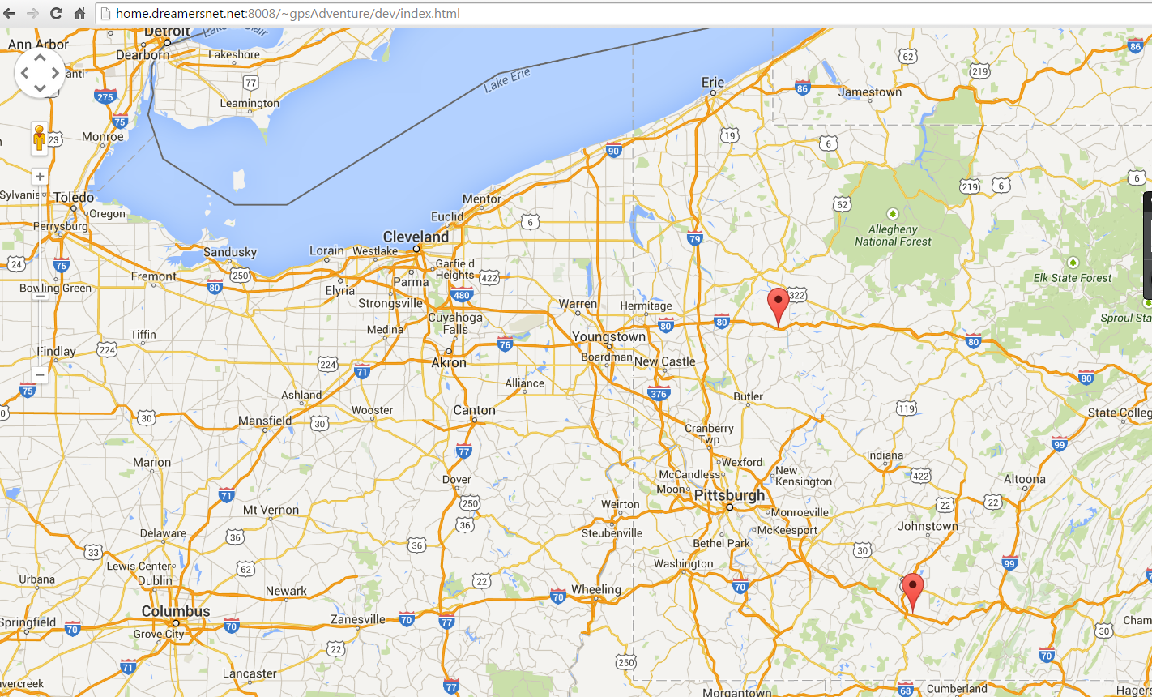
Google Maps

Slide 14
Conclusions
Google App Engine’s Python is good for prototyping
Google Maps Javascript API took care of mapping missions
Difficult to build User Interfaces

Slide 15
Future Work
GUI
User Management
Separate Mobile Application

